Slide 1
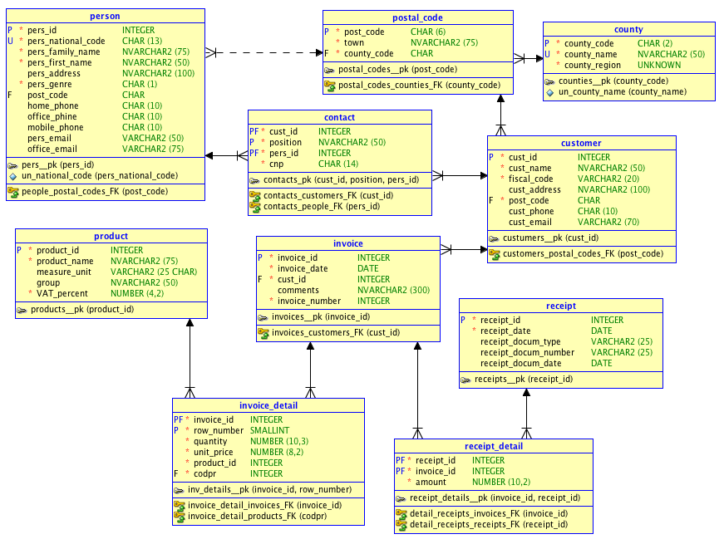
sales Relational Diagram

